Slide 1
Statistics in Sports: Course Introduction + Overview
Zachary Binney, PhD MPH
Oxford college of emory university
Fall 2021

Slide 2
Roadmap
1. Introductions (Us)
2. Introductions (The Course)
Applications in Sports
Course Structure
Syllabus Review

Slide 3
Introduction (Us)

Slide 4
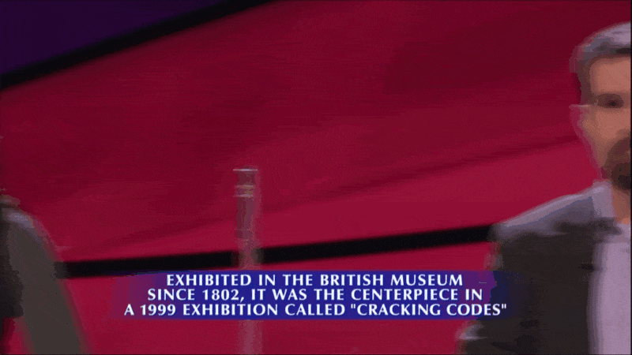
Who Am I?
PhD, Epidemiology, Emory, 2018
Assistant Professor of Quantitative Theory and Methods
Past: Adjunct Instructor at Emory and GSU
Statistical consultant for sports (NFL/MLB/NBA/NCAA) teams, pharmaceutical companies, media outlets
Past: healthcare consultant, end-of-life care
Staff Writer, FootballOutsiders.com
Been on Jeopardy!
...lost on Jeopardy!

Slide 5

Epidemiologists...They hunt viruses, right?
Source: https://lh3.googleusercontent.com/proxy/I8n7fzo7Q9XdWu1d0s1cyFj1eIuZGIz7_BjT9wtHHH1g3XZjffiATTjAHo-LPKh3cut8xqvtaG57zdoacmCQdH58l2xvQbCyl_wi7y62KeXizMB4

Slide 6
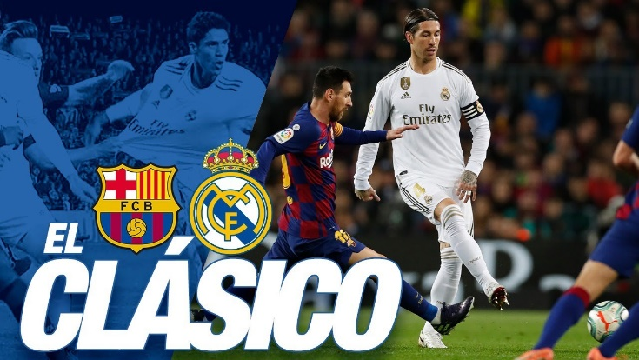
What is Epidemiology: Dictionary Definition
Epidemiology is the study of the distribution and determinants of health-related states or events in specified populations, and the application of this study to the control of health problems. (Last, Dictionary of Epi)
Source: https://www.youtube.com/watch?v=L6KB8WvtWPc

Slide 7
What is Epidemiology: My Definition
Epidemiology teaches you how to ASK and ANSWER questions about the world around you using rigorous, mostly quantitative, methods

Slide 8
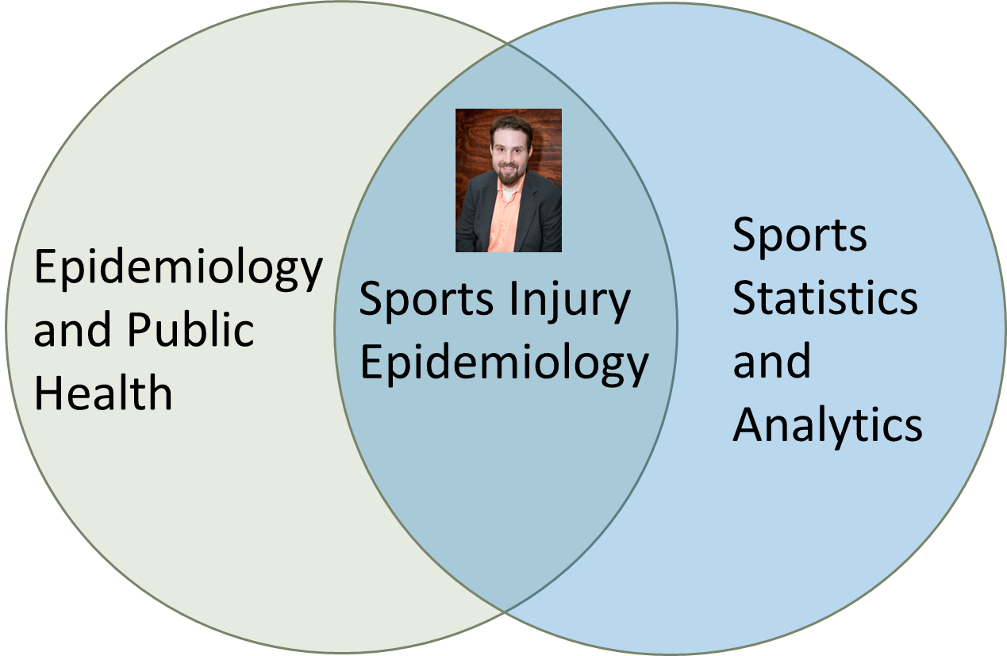
Sports Injury Epidemiology
Notes:
How many of you here are NFL football fans?
[Assuming few hands go up] Great, I love a challenge. One of my goals today is going to be to convince every one of you football and other sports injuries are an interesting and worthwhile topic to study.

Slide 9
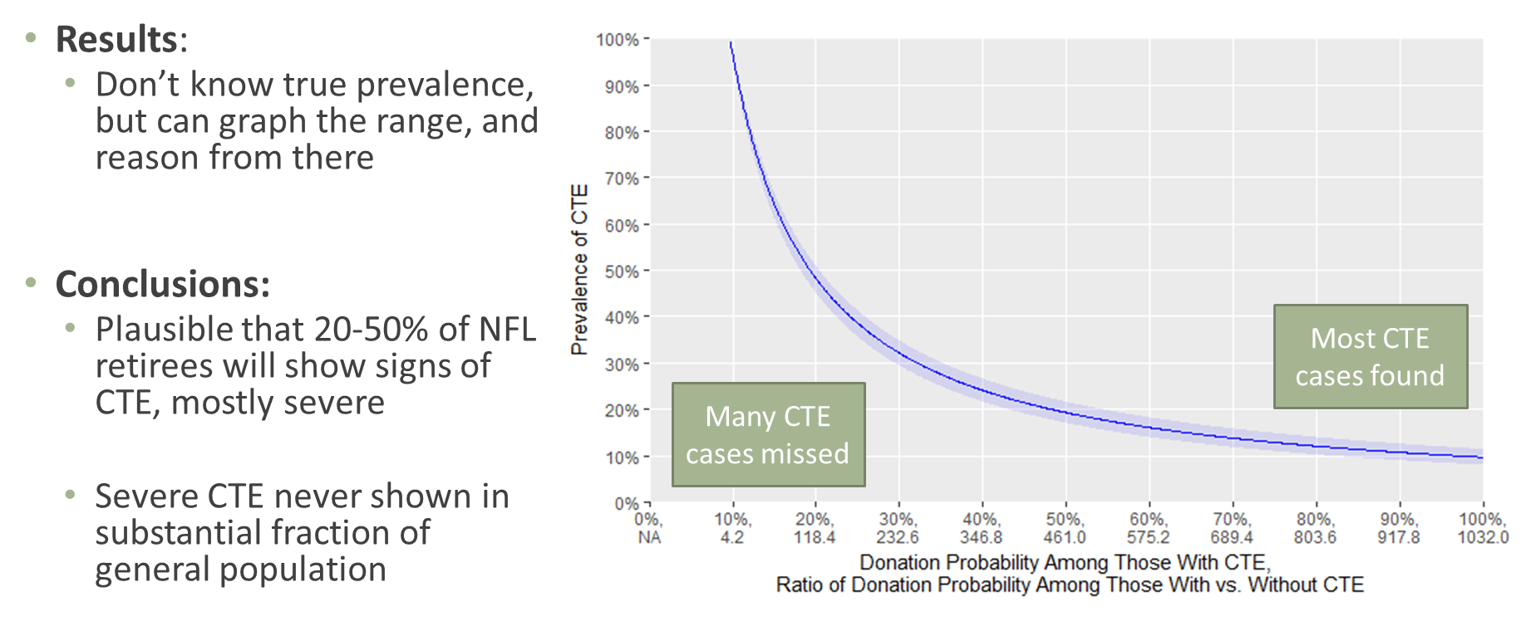
Sports Epidemiology
Public Work – chronic traumatic encephalopathy (CTE)
Problem: severely selected samples of dead ex-players who donated brains in CTE work
99% of donated brains had CTE != 99% of football players have CTE. But we know total # of players who died → possible donated brains. Use a little algebra and…
Source: https://www.nytimes.com/interactive/2017/07/25/sports/football/nfl-cte.html; https://n.neurology.org/content/92/1/43

Slide 10
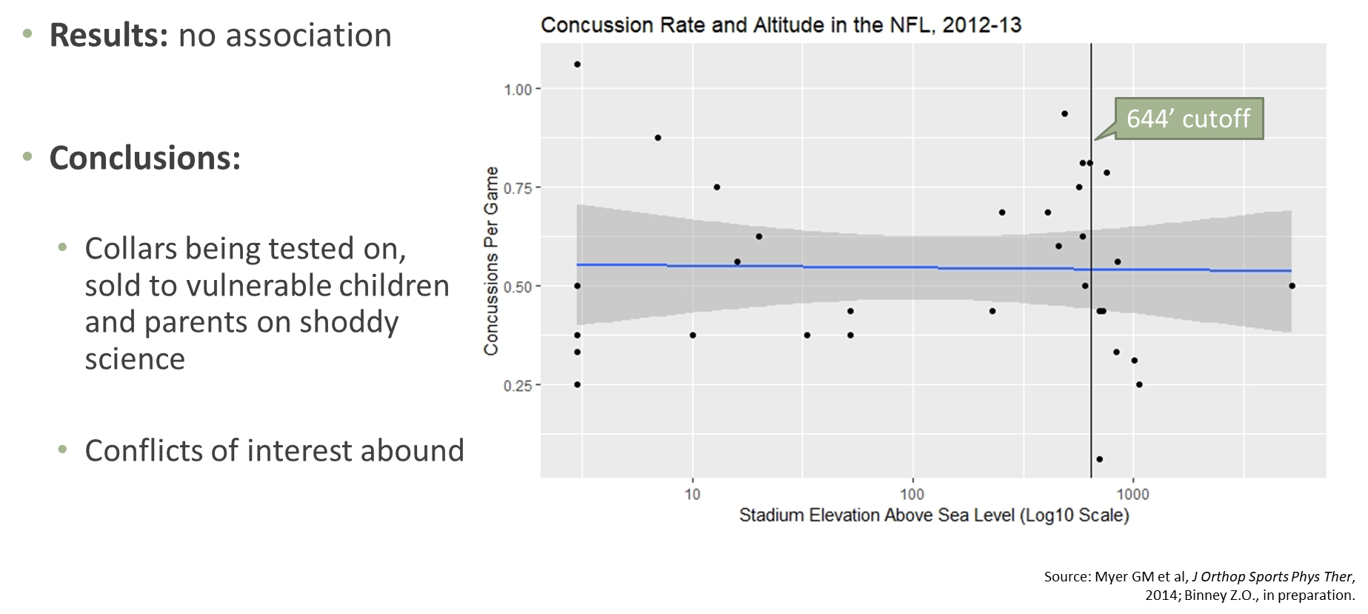
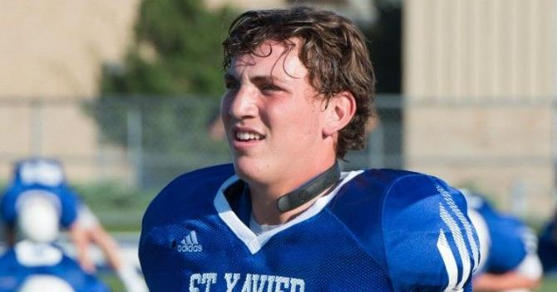
Sports Epidemiology
Public Work – bust snake oil
Claim: association between concussions and altitude (high vs. low) in NFL
Source: https://www.gannett-cdn.com/-mm-/0059de15fe182a2610bc8112ecfbb5bff2d47db6/c=0-0-749-423/local/-/media/2017/06/14/Cincinnati/Cincinnati/636330383188625054-qcollar.jpg?width=3200&height=1680&fit=crop
Notes:
I expect today’s presentation will be a teaching challenge, but by request I am focusing on my research today. I would just hope that none of this overshadows – especially in the students’ eyes – how important teaching and your success is to me. Agnes Scott prides itself on its undergraduate teaching, and I would hope I fit very well into that mission. I am excited to help develop an accessible, engaging, applied, active-learning-based, forward-thinking Epidemiology, Biostatistics, and broader Public Health curriculum

Slide 11
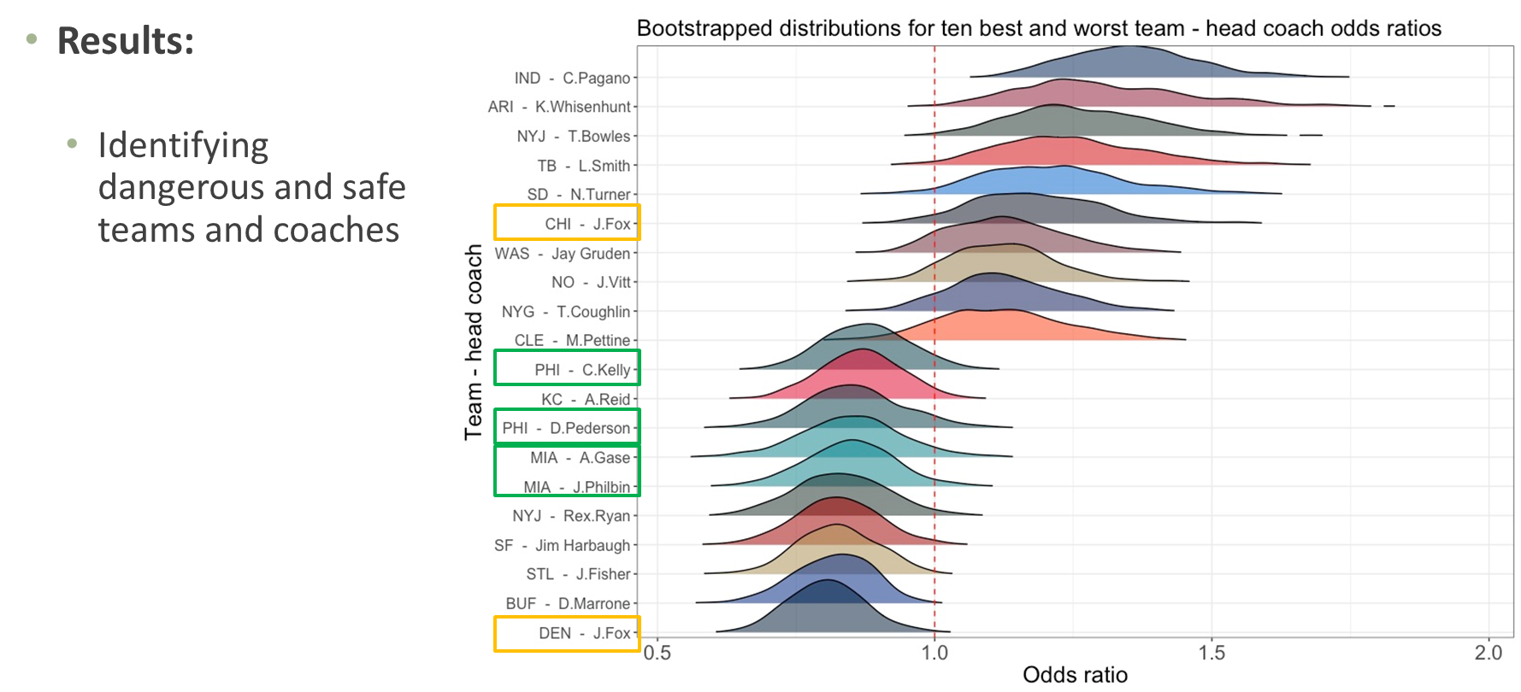
Sports Epidemiology
Public Work – identify NFL injury risk factors
Notes:
I expect today’s presentation will be a teaching challenge, but by request I am focusing on my research today. I would just hope that none of this overshadows – especially in the students’ eyes – how important teaching and your success is to me. Agnes Scott prides itself on its undergraduate teaching, and I would hope I fit very well into that mission. I am excited to help develop an accessible, engaging, applied, active-learning-based, forward-thinking Epidemiology, Biostatistics, and broader Public Health curriculum

Slide 12
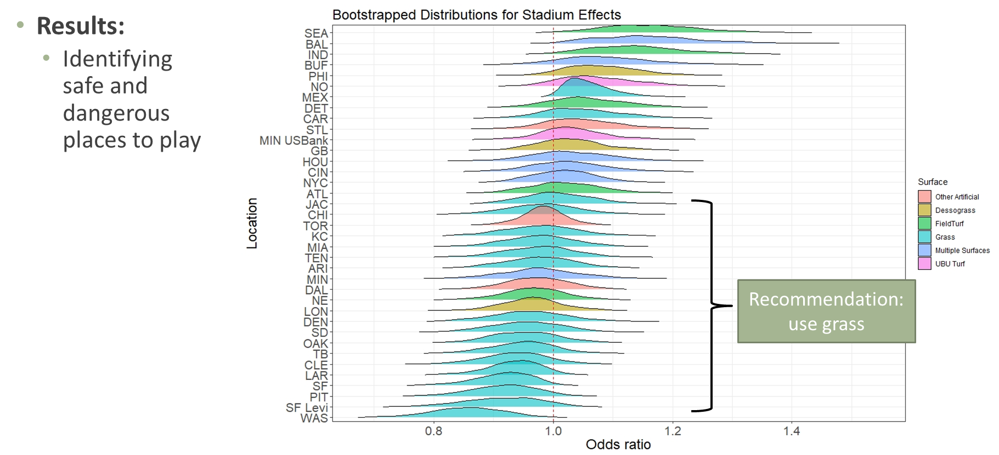
Sports Epidemiology
Public Work – identify NFL injury risk factors
Notes:
I expect today’s presentation will be a teaching challenge, but by request I am focusing on my research today. I would just hope that none of this overshadows – especially in the students’ eyes – how important teaching and your success is to me. Agnes Scott prides itself on its undergraduate teaching, and I would hope I fit very well into that mission. I am excited to help develop an accessible, engaging, applied, active-learning-based, forward-thinking Epidemiology, Biostatistics, and broader Public Health curriculum

Slide 13
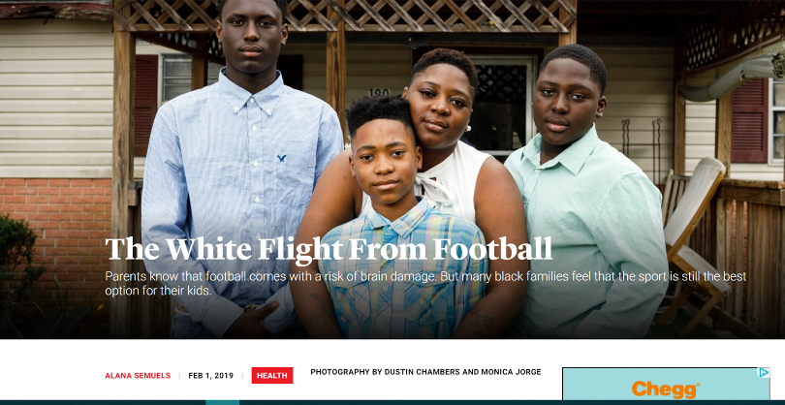
Children and Football
As we learn more about dangers to long-term health, who is left to play? Our most vulnerable children.
-6.6% nationwide in last decade
Declines in 40 total states; steepest declines in Rust Belt, northeast
Rising in south
NFL now >75% black
Source: The Atlantic (https://www.theatlantic.com/health/archive/2019/02/football-white-flight-racial-divide/581623/); https://www.theguardian.com/sport/2019/jan/30/high-school-football-numbers-drop-brain-trauma?CMP=share_btn_tw

Slide 14
Children and Football
HBO Real Sports: in Illinois from 2012-2017,
Players receiving public assistance
Total football players
+25%
-15%
Source: HBO Real Sports (https://www.youtube.com/watch?v=jwyWIcvHRi4&feature=youtu.be)

Slide 15
Who Are You?
Name
Where you’re from
Why this DSC? (Don’t tell us where you ranked it, but I know it was somewhere on your list.)
Athletic background, if any?
Teams you root for? (If any of you says Patriots I swear to God…)
Tell us your favorite something else. Food, hobby, book, movie, whatever!
Who’s the GOAT? Back up your argument.

Slide 16
Introduction (The Course)

Slide 17
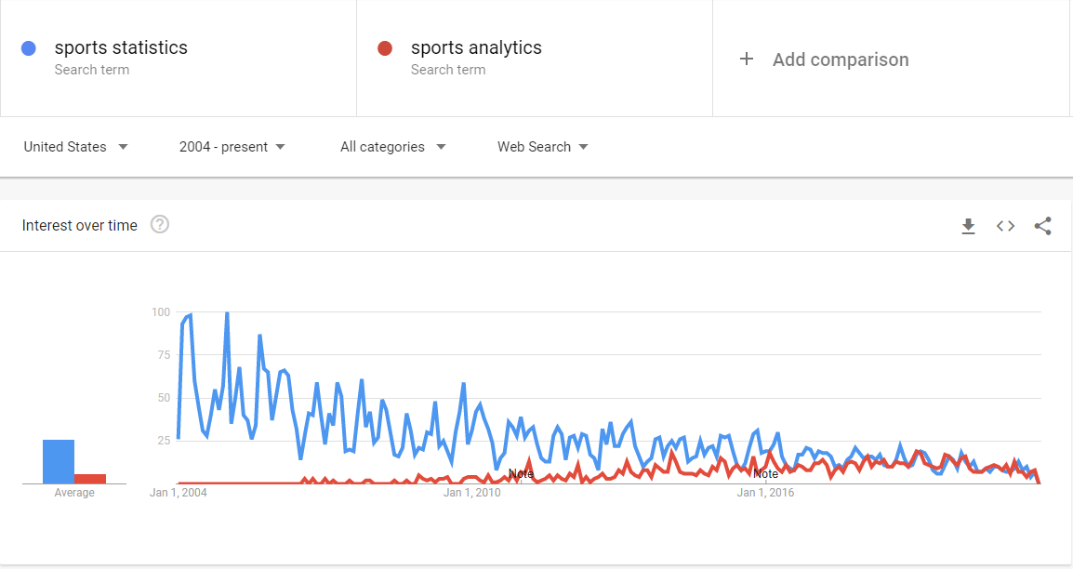
What is this class about?
Sports Analytics: my definition
Science of learning by asking and answering questions with data in sports
Source: Google Trends

Slide 18
What is this class about?
Sports Analytics: why do we need nerds?
Mental limitations/cognitive biases
Data isn’t perfect in this realm, either
Situational limitations (time)
Everyone, including coaches and scouts, uses data/stats – some don’t phrase it as “analytics”

Slide 19
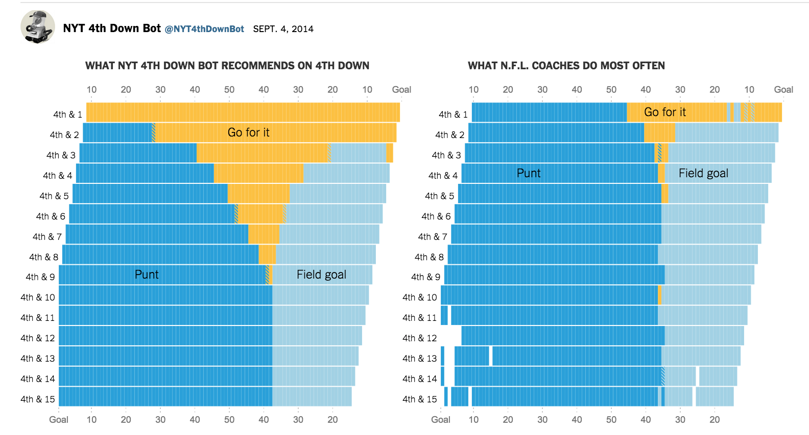
Sports Analytics Applications
In-game strategy and decision-making
Source:

Slide 20
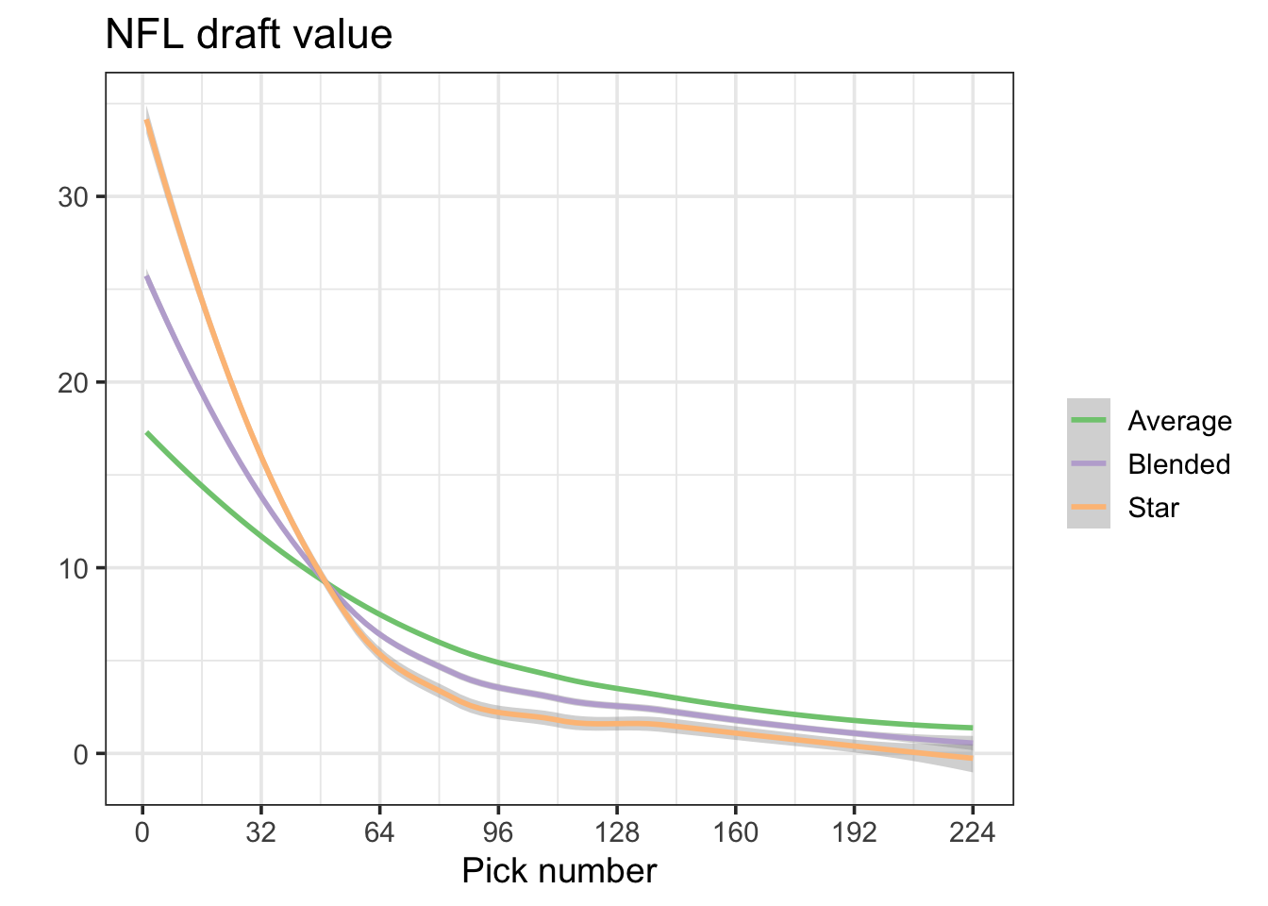
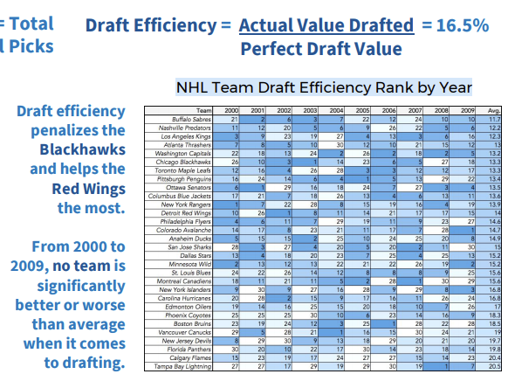
Sports Analytics Applications
Player evaluation (amateur scouting/draft strategy)
Source: https://statsbylopez.netlify.app/post/rethinking-draft-curve/, https://nessis.org/nessis17/Nandakumar.pdf

Slide 21
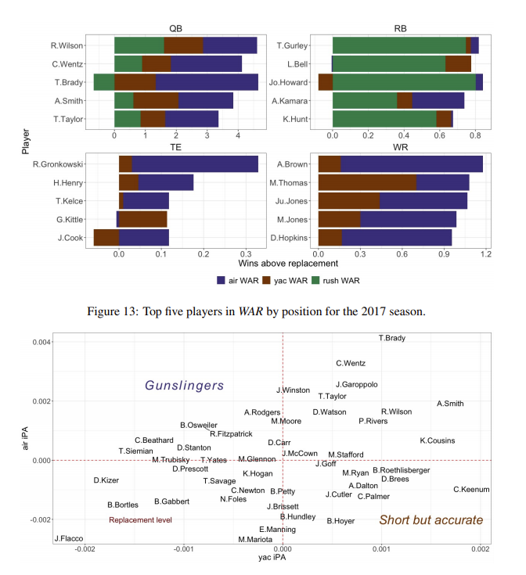
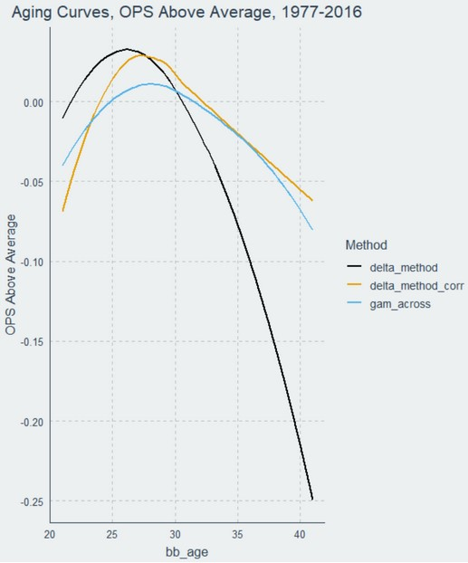
Sports Analytics Applications
Player evaluation (pro scouting)
Source: https://www.baseballprospectus.com/news/article/59972/the-delta-method-revisited/, https://arxiv.org/abs/1802.00998

Slide 22
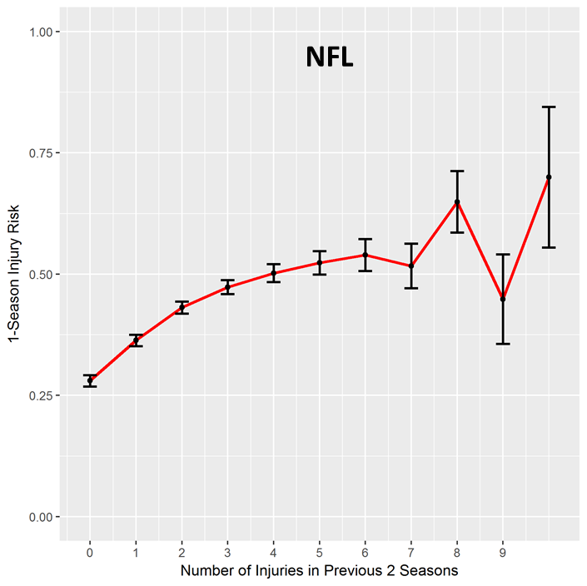
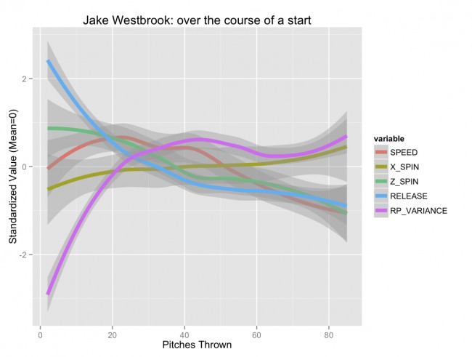
Sports Analytics Applications
Sports science, injuries, athlete health
Source: My dissertation on NFL injuries; https://tht.fangraphs.com/the-injury-zone-revisited/

Slide 23
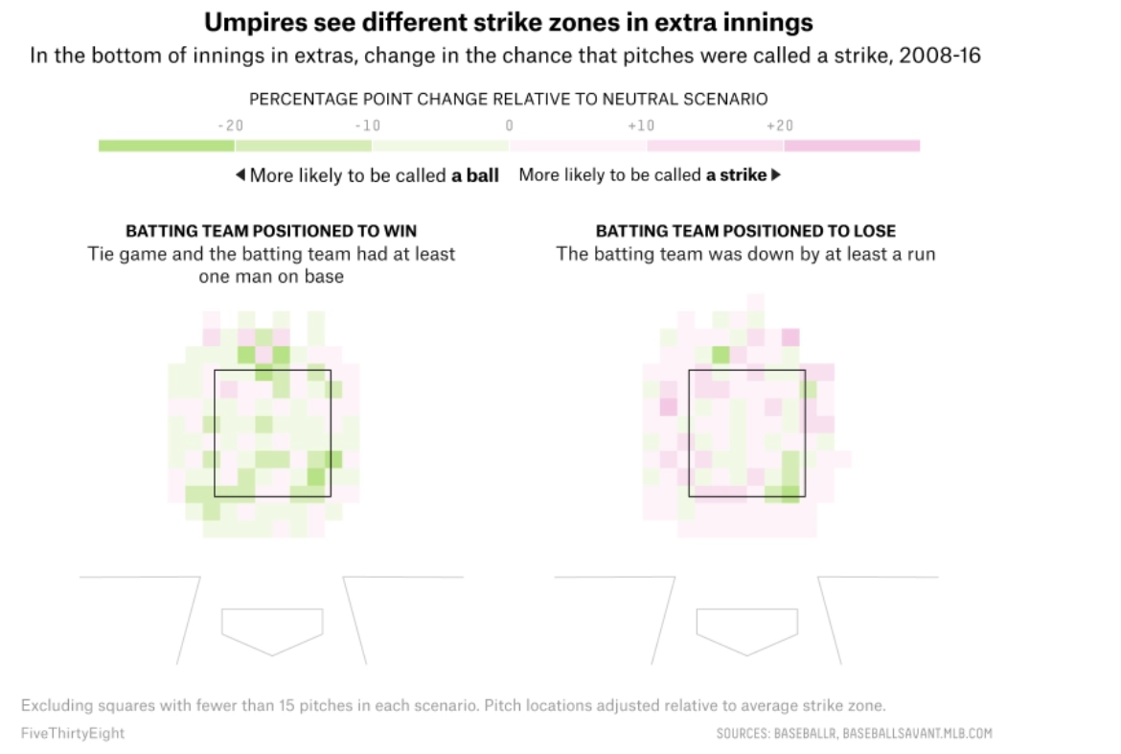
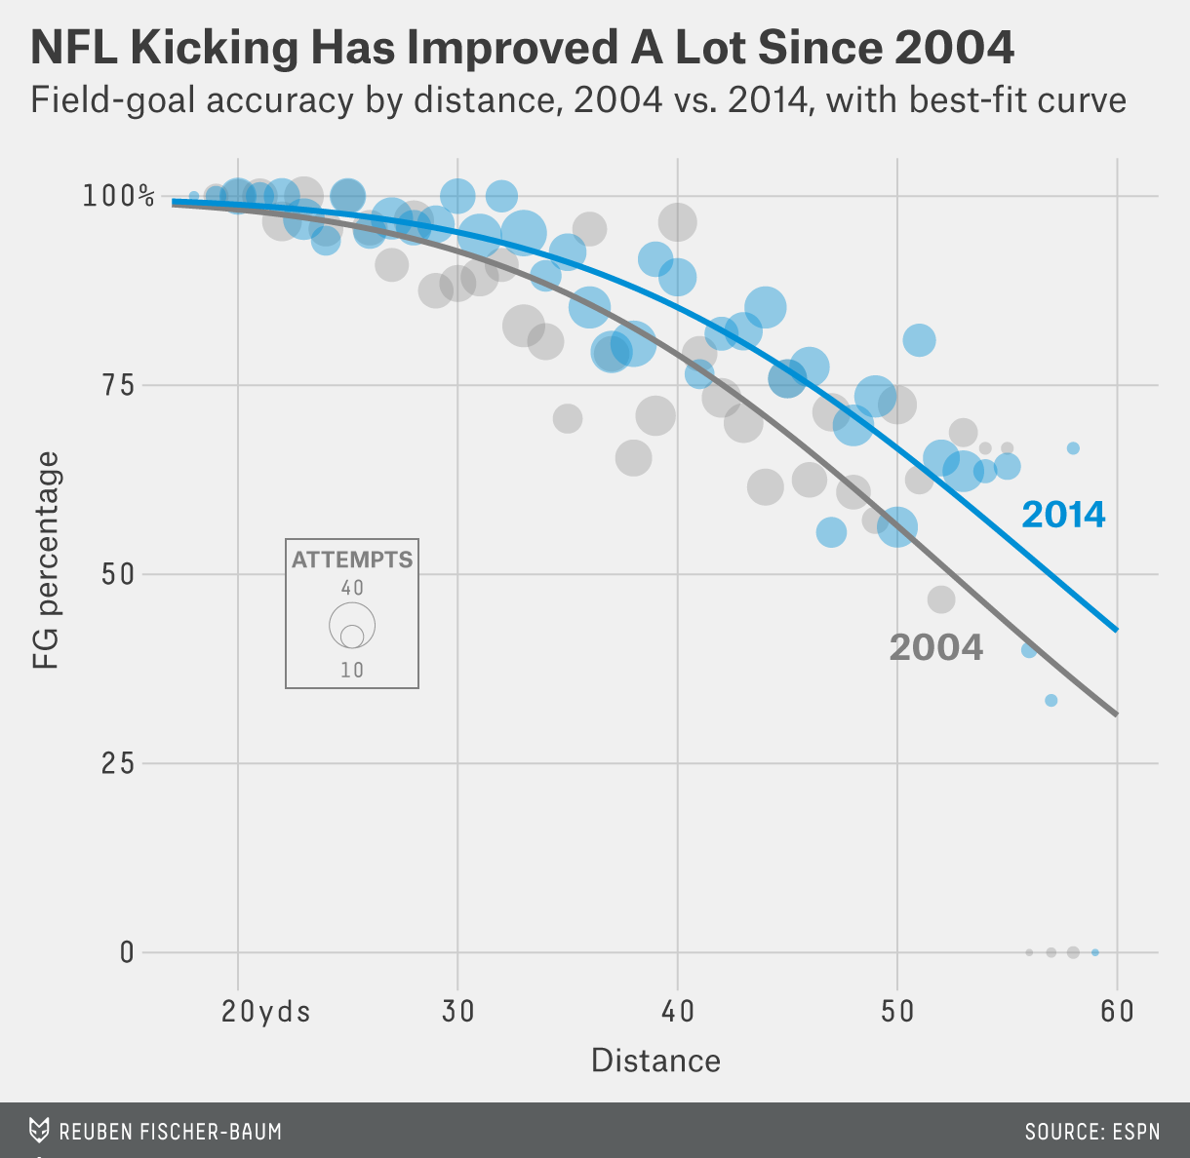
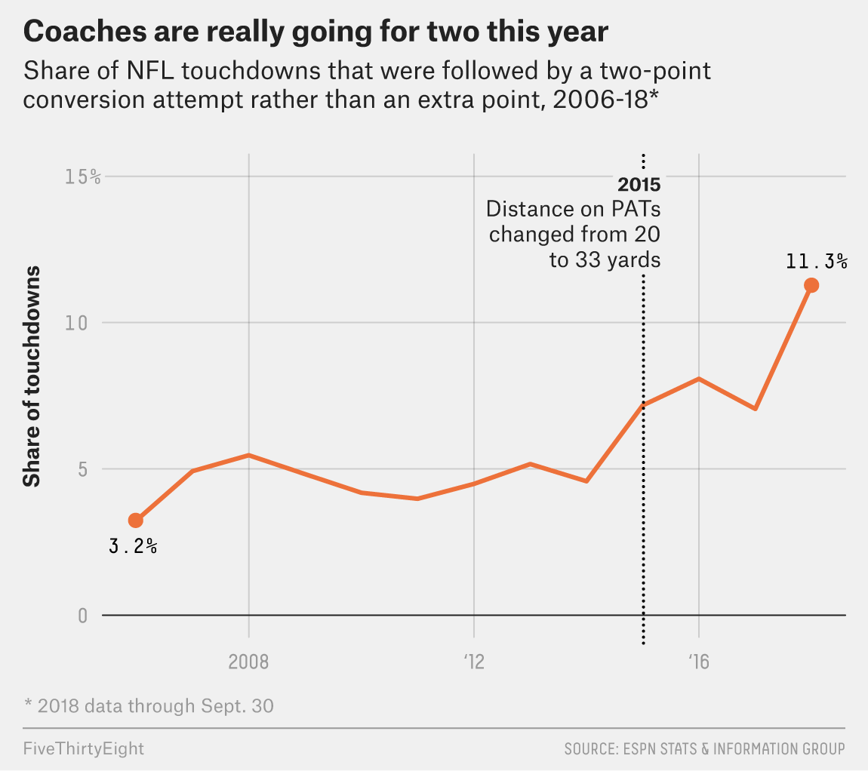
Sports Analytics Applications
League development (e.g. rule changes)
Source: https://fivethirtyeight.com/features/everyone-wants-to-go-home-during-extra-innings-maybe-even-the-umps/; https://operations.nfl.com/gameday/analytics/stats-articles/what-data-and-analytics-told-us-about-2021-offseason-nfl-rules-proposals/; https://fivethirtyeight.com/features/nfl-coaches-are-going-for-two-more-than-ever-it-took-them-long-enough/; https://fivethirtyeight.com/features/we-thought-nfl-kickers-would-keep-getting-better-but-this-year-theyre-struggling/; https://fivethirtyeight.com/features/kickers-are-forever/

Slide 24
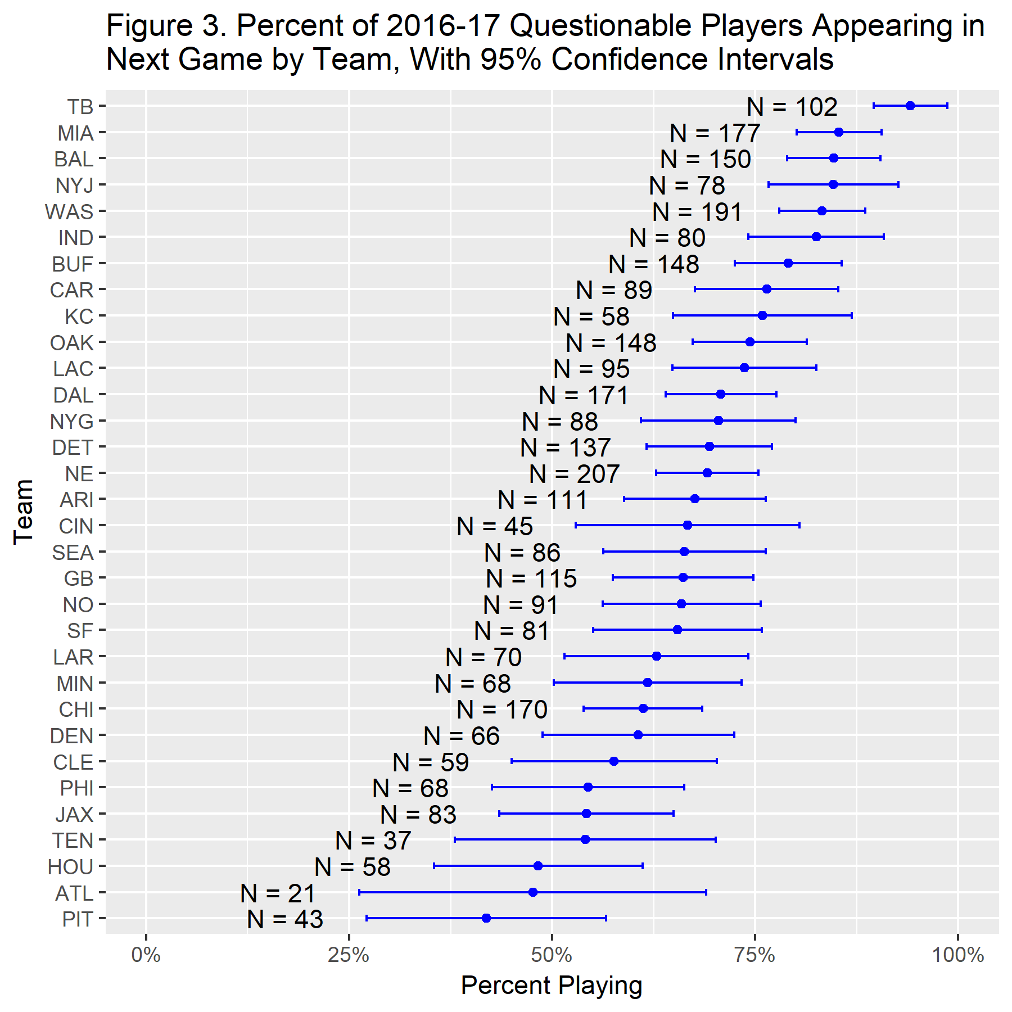
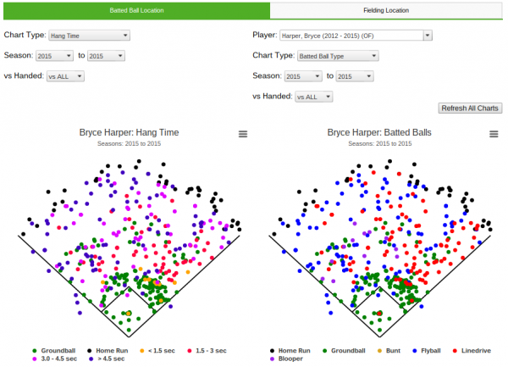
Sports Analytics Applications
Opponent Scouting
Source: https://library.fangraphs.com/features/spray-charts/, https://www.footballoutsiders.com/stat-analysis/2018/questionable-behavior

Slide 25
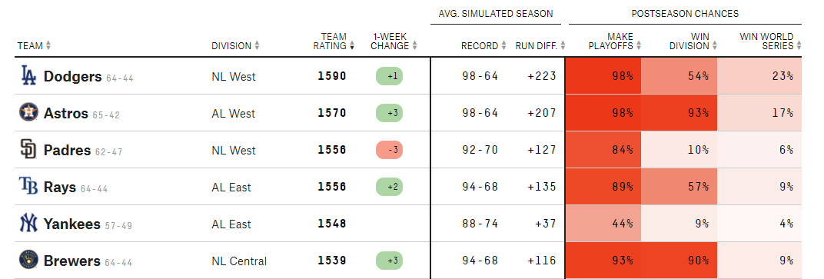
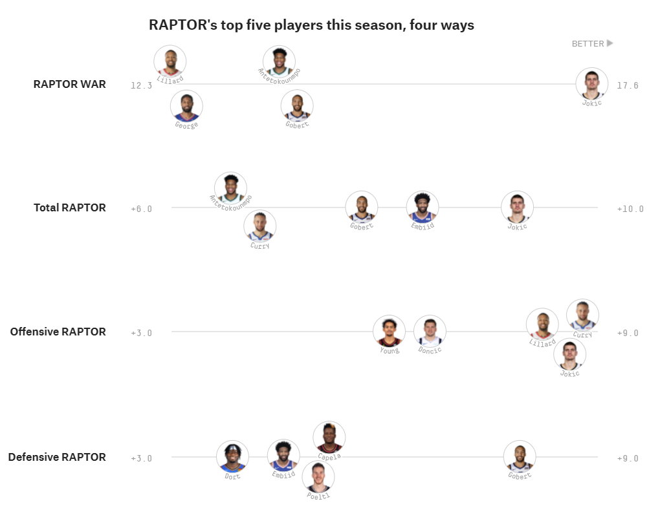
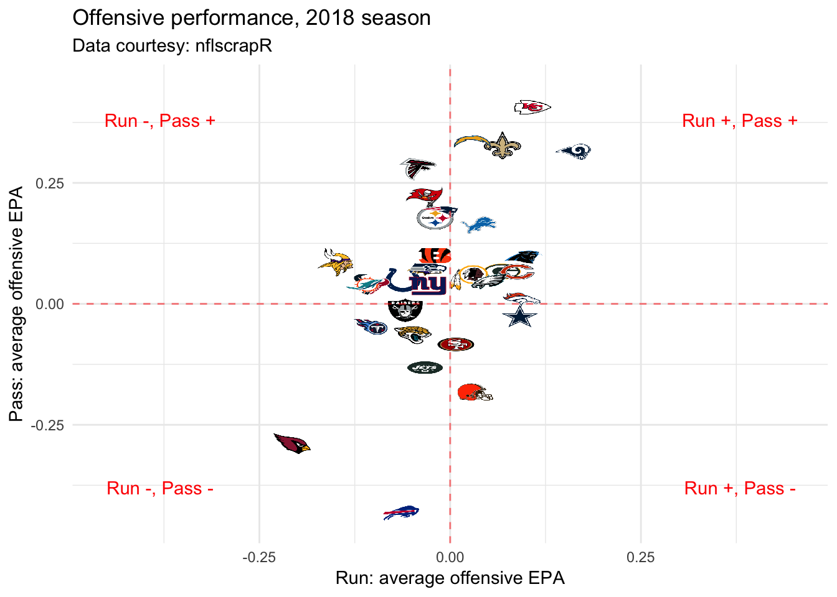
Sports Analytics Applications
Gambling and bar fights
Source: https://projects.fivethirtyeight.com/nba-player-ratings/; https://projects.fivethirtyeight.com/2021-mlb-predictions/ , https://statsbylopez.netlify.app/post/r-for-nfl-analysis/

Slide 26
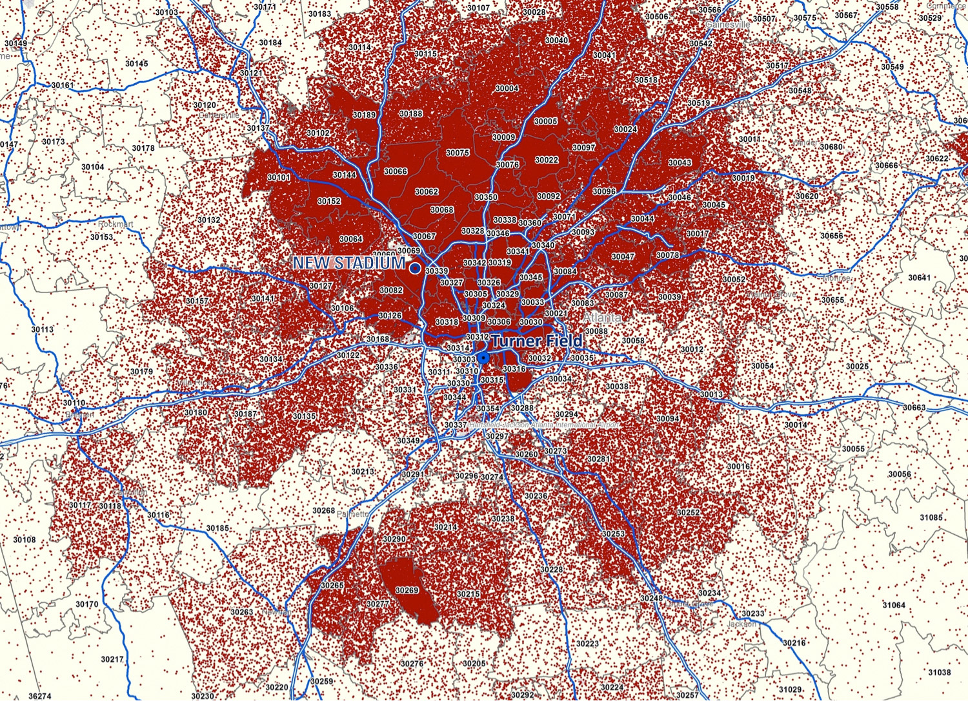
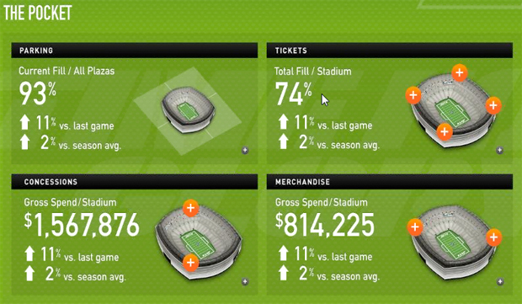
Sports Analytics Applications
Sports Business
Source: https://www.fastcompany.com/1686697/ny-jets-command-center-offers-real-time-analytics-sales-stats-freaks; https://ftw.usatoday.com/2013/11/why-the-braves-want-to-move-in-one-ticket-sales-map

Slide 27
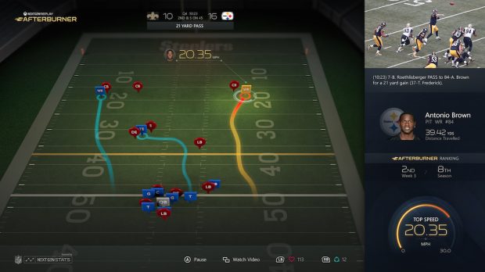
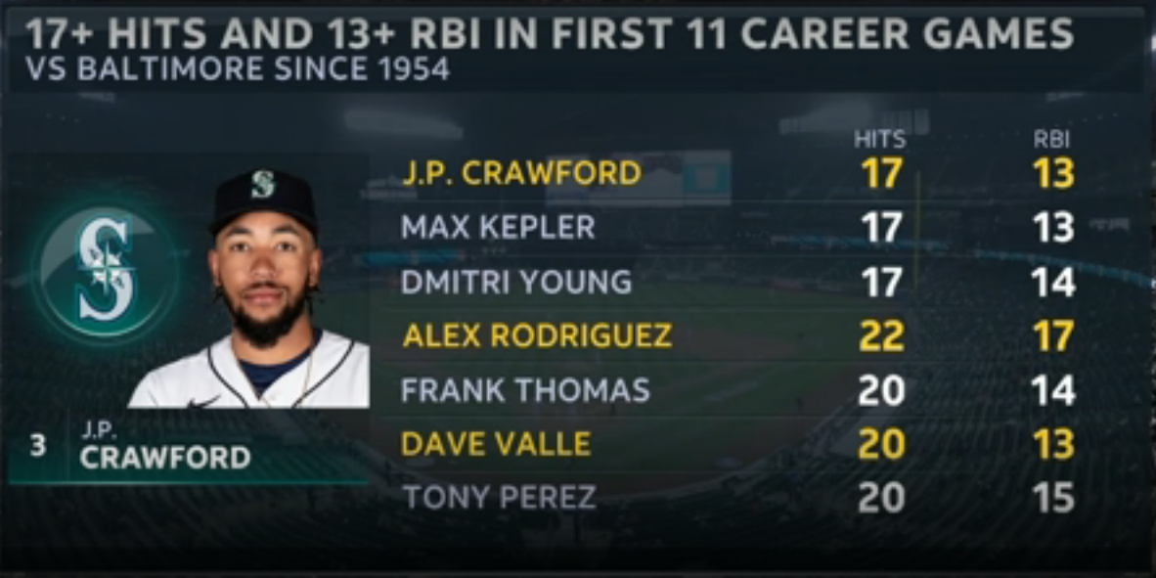
Sports Analytics Applications
Media and broadcasting, narratives
Source: https://www.reddit.com/r/baseball/comments/n4fake/root_sports_with_the_weirdly_specific_stat/, https://www.geekwire.com/2015/microsoft-will-show-next-gen-stats-on-nfl-app-thanks-to-rfid-chips-worn-by-players/

Slide 28
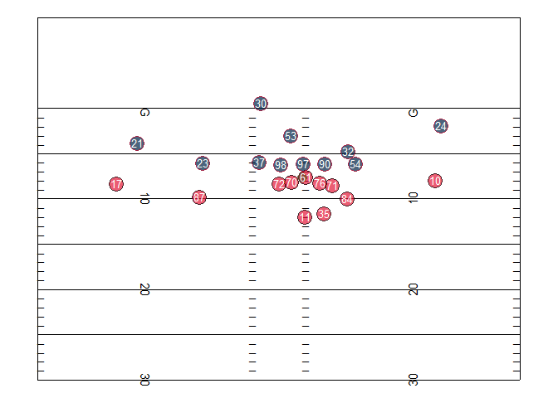
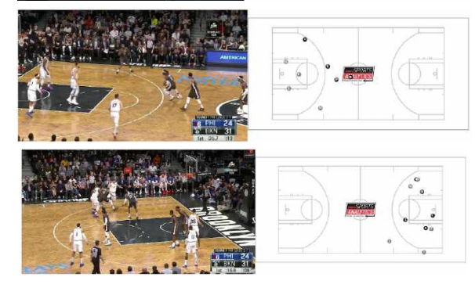
Sports Analytics Applications
Next frontier: Player tracking data
Source: https://statsbylopez.netlify.app/post/r-for-nfl-analysis/, https://www.sloansportsconference.com/research-papers/extracting-player-tracking-data-from-video-using-non-stationary-cameras-and-a-combination-of-computer-vision-techniques

Slide 29
What are we doing?
1. Improve our overall problem solving and critical thinking
2. Learn how we learn from data asking meaningful questions and rigorously examining relevant evidence in sports
3. Gain an understanding of basic statistical/analytical concepts and their applications in sports
Data Acquisition, Storage, and Access
Data Analysis
Data Visualization
4. Practice effectively communicating analytical findings, arguments, and conclusions to diverse audiences

Slide 30
Syllabus Review
Open your syllabi!
Just one additional note: you’re taking a class with Oxford’s only epidemiologist in the middle of a global pandemic. Lucky you!
I’m always here for questions – ask them at the start of class or outside class

Slide 31
Next Class
For next class:
Do the readings for today if you hadn’t already
Install R and Rstudio (complete “Tutorial 0”)
Open and skim – or work through, as time allows – Tutorial 1. I’ll walk through next week.
OPTIONAL: play around with the Lahman baseball database. Come up with a question you’d like to answer using it.

Slide 32

Thanks!
Questions? zbinney@emory.edu, @binney_z on Twitter

